Slide 1




Introduction
When planning and managing the development of a product….
To answer these
“How many features will be completed?”
questions using
Scrum,
we need to
estimate the size
of what we are
and
the
“When will we be done?”
building measure velocity (rate
“How much will this cost?”
at which we can get
work done).

Slide 2

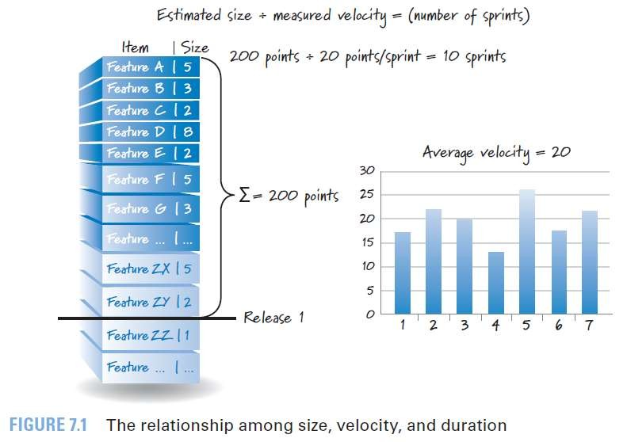

Slide 3

What and When We Estimate
Most organizations make estimates for purposes at three different levels of detail.
Portfolio Backlog,
Product Backlog,
Sprint Backlog Task.
planning

Slide 4

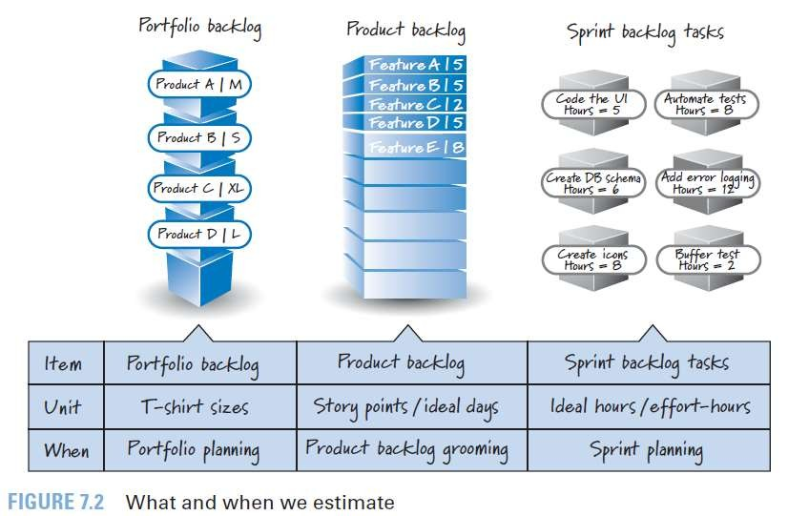

Slide 5

1. Portfolio Backlog Item Estimates (optional)
Many organizations choose to use rough, relative size estimates like T-shirt sizes (such as small, medium, large, extra large, and so on)

Slide 6

2. Product Backlog Estimates ***
Estimating PBIs is part of the overall product backlog grooming activity.
Most teams prefer to put numeric size estimates on them, using either story points or ideal days.

Slide 7

Why Estimate? (contd.)
Not all PBIs will be at the same size at the same time, so there will be some larger PBIs in the backlog even if we do have a collection of smaller, similarly sized items toward the top.
It can take some time for teams to acquire the skills to break down PBIs to be roughly the same size.

Slide 8

Why Estimate? (contd.)
Finally, values during
and most importantly, one of the primary
of estimation is the learning
happens the estimation conversations. Nothing
that
promotes a healthy debate like asking people to put a number on something, which will immediately surface any disagreements and force assumptions to be exposed. If we were to do away with estimation, we would need to substitute an equally effective way of promoting these healthy discussions.

Slide 9

3. Task Estimates (Sprint Backlog)
At the most detailed level we have the tasks that reside in the sprint backlog.
Most teams choose to size their tasks during sprint planning so that they can acquire confidence that the commitments they are considering are reasonable.
Tasks are sized in ideal hours (also referred to as effort-hours, man-hours, or person-hours)

Slide 10
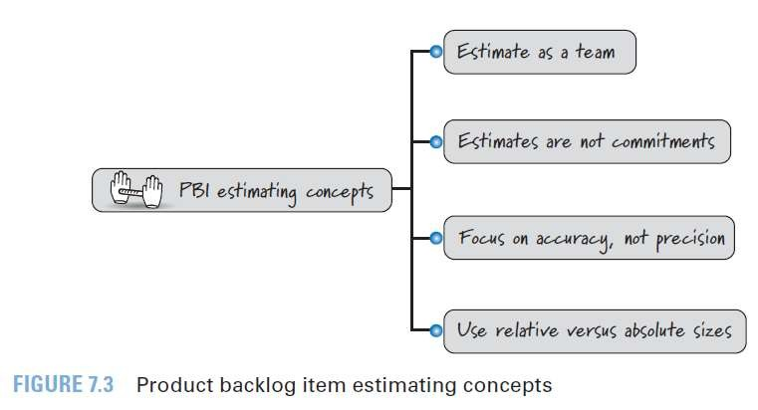
PBI Estimation Concepts

Slide 11

1. Estimate as a Team
Traditional Approach
Project manager, product manager, architect, or lead developer might do the initial size estimation.
Other team members might get a chance to review and
comment on those estimates at a later time.
Scrum Approach
The people who will do the work collectively provide the estimates. (Development team that will do the hands-on work to design, build, and test the PBIs. )
The product owner and Scrum Master don’t provide estimates. Both of these roles are present when the PBIs are being estimated, but they don’t do any hands-on estimation

Slide 12
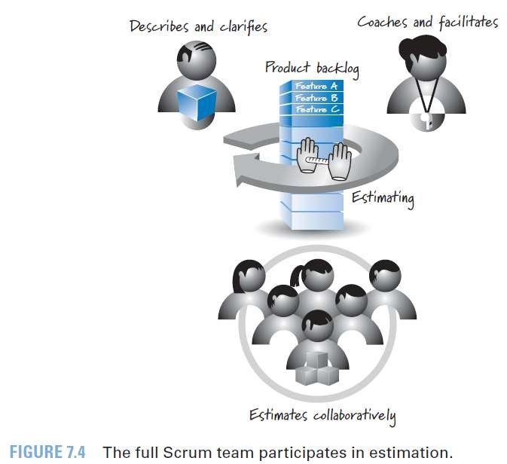

Slide 13

2. Estimates Are Not Commitments
If we ask people to estimate a story’s size, we expect to get a realistic estimate. If we then tell them their salaries/bonuses will be based on the work due on time, everyone will give a much larger estimate than the one we originally thought was correct.
The estimates ought to be a realistic measure of how big something is.

Slide 14

2. Estimates Are Not Commitments
We don’t want them artificially inflated due to external influences.
That behavior only results in bloated schedules and a back-and-forth game of estimate inflation by team members and reduction by management.
When all is said and done, we have no real understanding of the numbers because they have been manipulated so many times by different people.

Slide 15

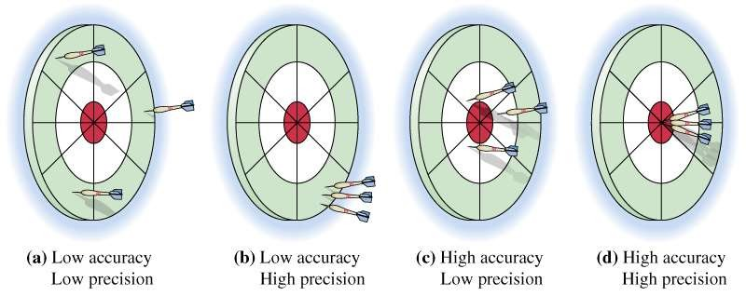
(Accuracy Vs Precision)
Accuracy: The closeness of a given measurement to its true value.
Precision: The stability of that measurement when repeated many times.

Slide 16

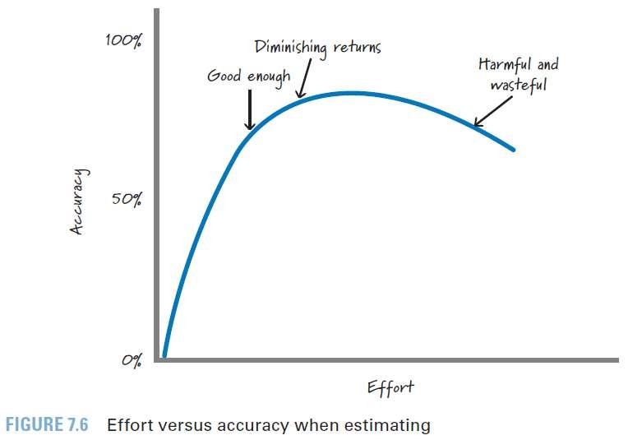
3. Focus on Accuracy, Not Precision
Our estimates should be accurate without being overly precise.
We should invest effort to get a good-enough, roughly right estimate.

Slide 17
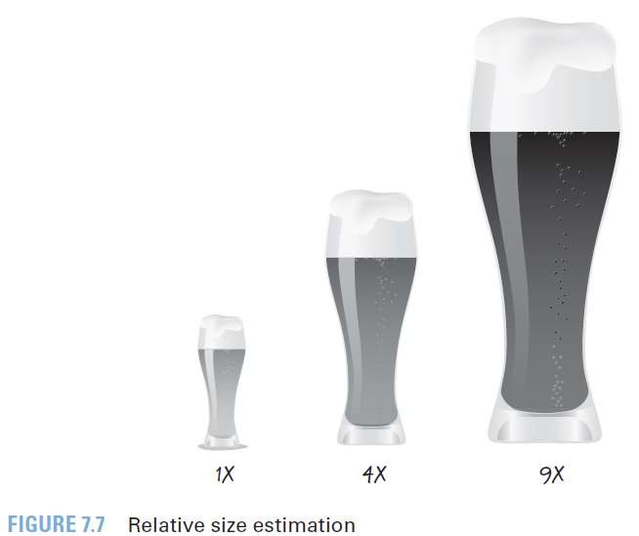
4. Relative Size Estimation
We should estimate PBIs using relative sizes, not absolute sizes.
We compare items to determine how large an item is relative to the others.
People are much better at relative size estimation than absolute size estimation

Slide 18
PBI Estimation Units
Although there is no standard unit for PBI estimates, by far the two most common units are
Story Points
Ideal Days.
size

Slide 19

1. Story Points (contd.)
Story points measure the bigness or magnitude of a PBI.
Scenario 1 :
Let’s say we have to update every cell in a 60,000-cell spreadsheet. None of the individual updates is difficult, but the updates can’t be automated.
How much of this work can we get done in a sprint? Though not complex, this would be a large story.

Slide 20

Story Points (contd.)
The goal is to be able to compare stories and say things like “Well, if the create-a-ticket story is a 2, then the search-for-a-ticket story is an 8,” implying that the searching story is roughly four times the size of the creation story.
Because size measures like story points are ultimately used to calculate time (duration), story points must reflect the effort associated with the story from the development team’s perspective.

Slide 21


2. Ideal Days
Ideal days are not calendar days.
They represent the number of effort-days or person- days needed to complete a story.
“How big is this PBI?”
“Two days.”
“OK today is Wednesday, so you’ll
be done on Friday.”
“No, I don’t have any full day tomorrow to dedicate to the PBI as I need an entire day just to get caught up. I’m thinking I should be done sometime next Monday.”
“I don’t understand; you told me it was a two-day PBI, so you should be done on Thursday.”
“I said two ideal days, not two calendar days”

Slide 22

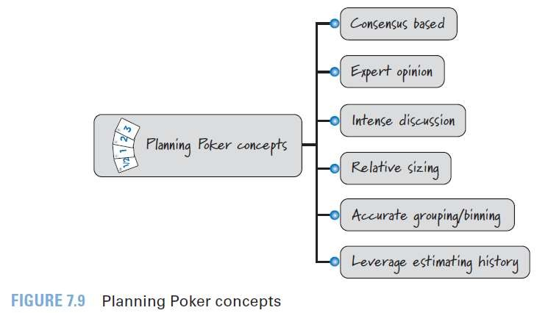
Planning Poker (contd.)
Planning Poker is a technique for sizing PBIs.

Slide 23

Planning Poker (contd.)
Planning Poker is a consensus-based technique for estimating effort.
Knowledgeable people (the experts) slated to work on a PBI engage in an intense discussion to expose assumptions, acquire a shared understanding, and size the PBI.
Planning Poker yields relative size
accurately grouping or binning
estimates by
of
together items
similar size.
The team leverages its established PBI estimation history to more easily estimate the next set of PBIs.

Slide 24
Estimation Scale in Planning Poker
To perform Planning Poker, the team must decide which scale or sequence of numbers it will use for assigning estimates.
Because our goal is to be accurate and not overly precise, we prefer to not use all of the numbers.
Instead, we favor a scale of sizes with more numbers at the small end of the range and fewer, more widely spaced numbers at the large end of the range.

Slide 25
Estimation Scale in Planning Poker (contd.)
The most frequently used scale,
Fibonacci sequence: 1, 2, 3, 5, 8, 13, 20, 40, and 100.
An alternative scale that some teams use is based on powers of 2:
1, 2, 4, 8, 16, 32
When using this type of scale, we group or bin together similar-size like PBIs and assign them the same number on the scale.

Slide 26
Poker Game in Scrum
The full Scrum team participates when performing Planning Poker.
During the session, the product owner presents, describes, and clarifies PBIs.
The ScrumMaster coaches the team to help it better.
The ScrumMaster is also constantly looking for people who, by their body language or by their silence, seem to disagree and helping them engage.
And the development team is collaboratively generating the estimates.

Slide 27

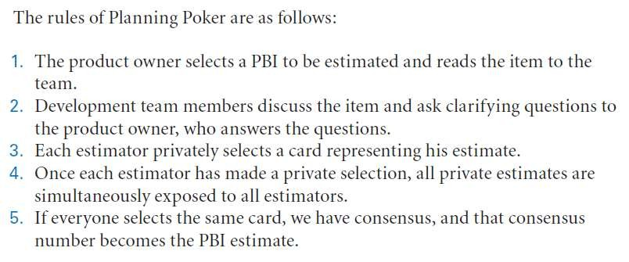
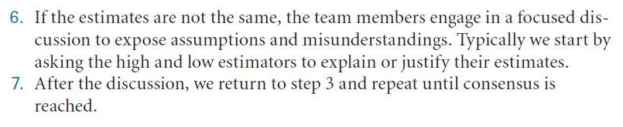

Slide 28
Poker Game in Scrum
Usually consensus can be achieved within two or three rounds of voting, during which the team members’ focused discussion helps obtain a shared understanding of the story.
Planning Poker brings together the diverse team of people who will do the work and allows them to reach consensus on an accurate estimate that is frequently much better than any individual could produce.

Slide 29

What Is Velocity?
Velocity is the amount of work completed each sprint.
It is measured by adding the sizes of the PBIs that are completed by the end of the sprint.
A PBI is either done or it’s not done.
The product owner doesn’t get any value from undone items, so velocity does not include the size numbers of partially completed PBIs.

Slide 30

What Is Velocity? (contd.)
Velocity measures output (the size of what was delivered), not outcome (the value of what was delivered).
We assume that if the product owner has agreed that the team should work on a PBI, it must have some value to him.
However, completing a PBI of size 8 doesn’t necessarily deliver more business value than completing a PBI of size 3.
Perhaps the PBI of size 3 is high value and therefore we work on it early (because it is high value and low cost), and we work on the PBI of size 8 later (because it is lower value and higher cost).

Slide 31
What Is Velocity? (contd.)
Velocity is used for two important purposes.
First, it is an essential concept for Scrum planning.
For release-level planning, we divide the size of the release by the team’s average velocity to calculate the number of sprints necessary to complete the release.
Additionally, at sprint planning, a team’s velocity is used as one input to help determine its capacity to commit to work during the upcoming sprint.

Slide 32

What Is Velocity? (contd.)
Second, velocity is also a diagnostic metric that the team can use to evaluate and improve its use of Scrum to deliver customer value.
By observing its own velocity over time, the team can gain insight into how specific process changes affect the delivery of measurable customer value.

Slide 33


Calculate a Velocity Range
For planning purposes, velocity is most useful when expressed as a range. Using a range allows us to be accurate without being overly precise.
“The team is typically able to complete between 25 and 30 points each sprint.”
it’s impossible to give a very precise answer. By using a range, we can communicate our uncertainty.

Slide 34
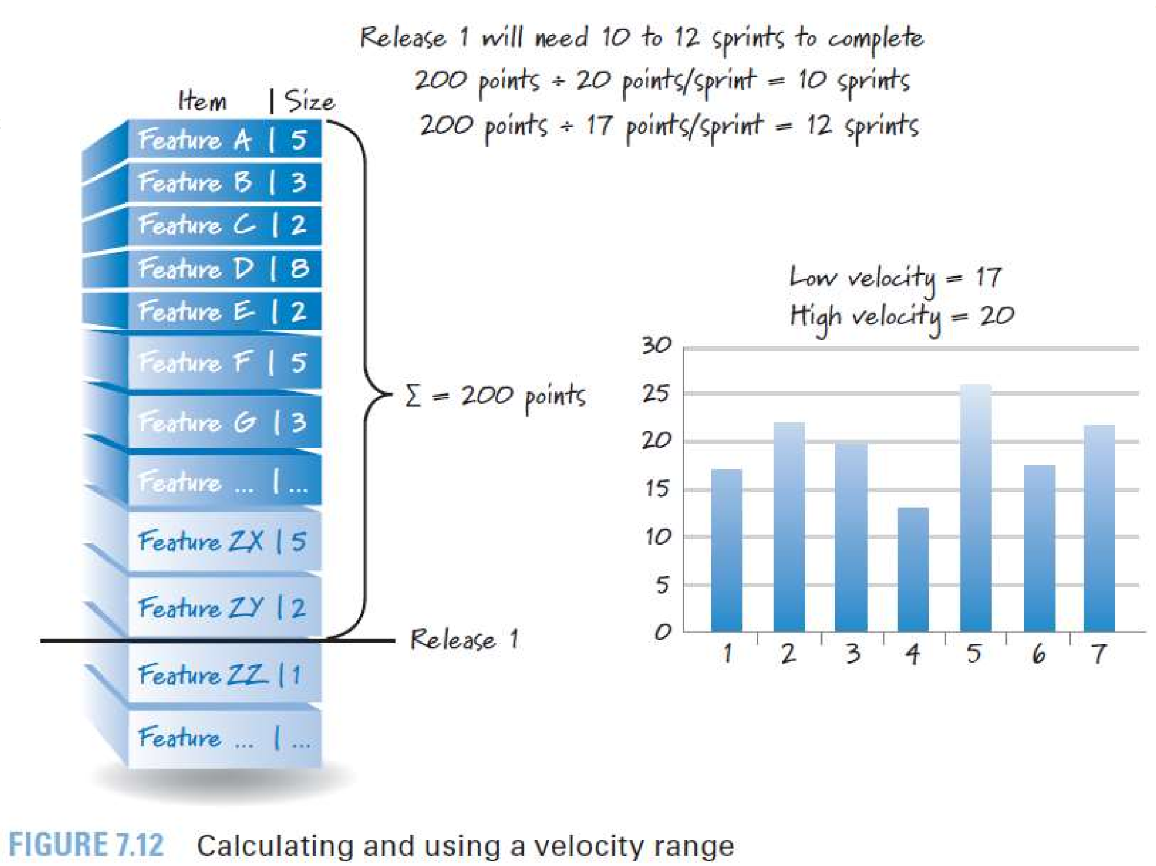


Slide 35
Forecasting Velocity
One of the benefits of having long lived teams is that they will acquire such useful historical velocity data that we could use to predict future velocity.
But how do we handle the situation where we have a new team whose members haven’t worked together and therefore have no historical data? We’ll have to forecast it.

Slide 36

Forecasting Velocity (contd.)
One common way to forecast a team’s velocity is to have the team perform sprint planning to determine what PBIs it could commit to delivering during a single sprint.
If the commitment seems reasonable, we would simply add the sizes of the committed PBIs and use that as the team’s forecasted velocity.
Because what we really want is a velocity range, we could have the team plan two sprints and use one estimated velocity number as the high and the other as the low (the two estimates would likely be different).

Slide 37
Forecasting Velocity (contd.)
Alternatively, we could make some adjustments to one estimated velocity based
intuitive
on
historical data for other teams, thereby converting the one estimate into a two-estimate range.
As soon as the team has performed a sprint and we have an actual velocity measurement, we should discard the forecast and use the actual.
And as the team builds up a history of actual velocities, we should compute averages or apply other statistics to the data to extract a velocity range.

Slide 38

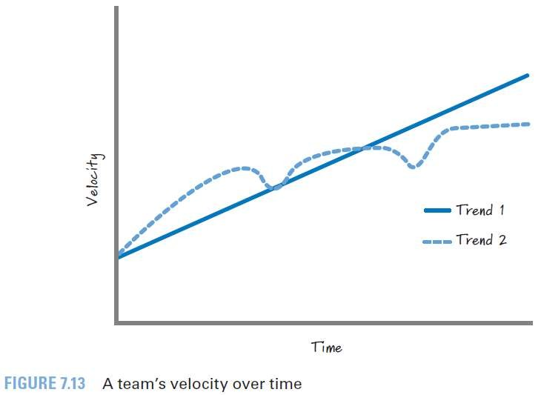
Affecting Velocity
Team’s velocity should constantly increase over time????

Slide 39
Affecting Velocity (contd.)
If the team is constantly inspecting
and adapting
(continuously improving), its velocity should keep getting better and better.
A team that is aggressively trying to improve itself and is focused on delivering features in accordance with a robust definition of done and low technical debt can see an increase in velocity. Well, at least an increase up to a certain point, at which time its velocity will likely plateau.

Slide 40
Affecting Velocity (contd.)
Just because a team’s velocity has leveled out doesn’t mean there is no more upward potential.
There are a number of ways that the Scrum team and managers can help get velocity to the next plateau.
For example, introducing new tools or increasing training can have a positive effect on velocity.
Or managers can strategically change team composition with the hope that the change will eventually lead to a greater overall velocity.

Slide 41
Affecting Velocity (contd.)
Of course, managers should be careful because haphazardly moving people on and off teams can and probably will cause velocity to decline.
Although introducing new tools, getting training, or changing team composition can have a positive effect on velocity, these actions usually cause a dip in velocity while the team absorbs and processes the change.
After this decline, there will probably be an increase to the point where the team establishes a new plateau until some other change causes yet another plateau to be achievable.

Slide 42

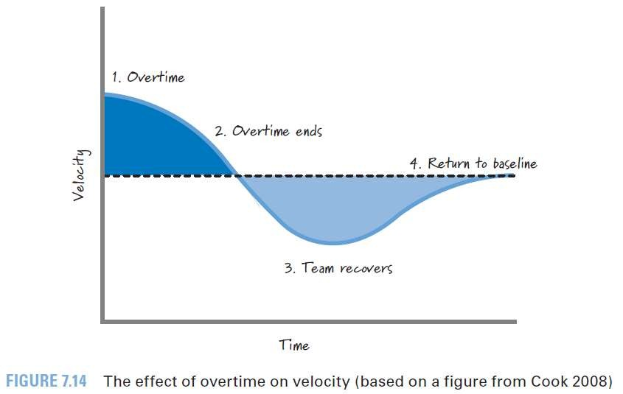
Affecting Velocity (contd.)
Of course, there is one obvious thing we could do to try to improve velocity: work longer hours.
Working a lot of consecutive overtime might initially cause velocity to increase.
That almost followed
increase will certainly be by an
in
aggressive
decline
velocity along with a simultaneous decline in quality.

Slide 43
Affecting Velocity (contd.)
Even after the overtime period ends, the team will need some amount of time to recover before returning to its reasonable baseline velocity.
Mostly the trough (decreased velocity area) during the recovery period is larger than the crest (increased velocity area) during the overtime period.
The end result is that lots of overtime may provide some short-term benefits, but these are frequently far outweighed by the long-term consequences.

Slide 44

Misusing Velocity
Velocity is used as a planning tool and as a team diagnostic metric.
It should not be used as a performance metric in an attempt to judge team productivity.
When misused in this way, velocity can motivate wasteful and dangerous behavior.
For example, say We have decided to give the largest bonus to the team that has the highest velocity.
Superficially this idea might seem sensible; the team with the highest velocity must be getting the most work done each sprint, right? So, why not reward that behavior?

Slide 45

Misusing Velocity (contd.)
Well, if I’m comparing teams that aren’t sizing their PBIs using a common baseline (which is very likely true), comparing the numbers would make no sense.
Let’s say that team A assigns a value of 5 to a PBI, whereas team B assigns a value of 50 to the same PBI.
Team A doesn’t really want me to compare its velocity against team B’s velocity.
Team B’s velocity will be ten times that of team A, even if both teams actually get about the same quantity of work completed each sprint.

Slide 46

Misusing Velocity (contd.)
Once team A sees the problem, its members will start to game the system to ensure that their velocity numbers are higher.
The easy way to do this is to just change the scale the team uses to estimate PBIs.
So, team A now sizes the same item (the one it originally sized a 5) to be a 500.
We call this behavior point inflation, and it serves no purpose other than to align a team’s behavior with a misguided measurement system.
Don’t do this.

Slide 47

Misusing Velocity (contd.)
If we set up the reward system to favor bigger numbers, that’s exactly what I’ll get—bigger numbers (point inflation).
Even worse than point inflation is when teams cut corners to get more “done” in an effort to achieve higher, more desirable velocities. Doing so leads to increasingly greater levels of technical debt.
At the end of the day, we should judge velocity on how well it assists us with performing accurate planning and how well it helps a team to internally improve itself.
Any other uses will likely promote the wrong behavior.

